Slide 1
Unit 6: Graph
Prepared By:
Tanvi Patel
Asst. Prof. (CSE)

Slide 2
Contents
Graph Terminologies
Adjacency Matrices
List Representations of Graphs
Elementary Graph Operations: Depth First Search & Breadth first Search,
Spanning Trees: Shortest path,
Minimal spanning tree using graphs, networks.

Slide 3
Introduction
A graph data structure is a collection of nodes that have data and are connected to other nodes.
Let's try to understand this through an example. On facebook, everything is a node. That includes User, Photo, Album, Event, Group, Page, Comment, Story, Video, Link, Note...anything that has data is a node.
Every relationship is an edge from one node to another. Whether you post a photo, join a group, like a page, etc., a new edge is created for that relationship.

Slide 4

Introduction
All of facebook is then a collection of these nodes and edges. This is because facebook uses a graph data structure to store its data.
More precisely, a graph is a data structure (V, E) that consists of
A collection of vertices V
A collection of edges E, represented as ordered pairs of vertices (u,v)
In the graph,
V = {0, 1, 2, 3}
E = {(0,1), (0,2), (0,3), (1,2)}
G = {V, E}

Slide 5
Graph Terminologies
Adjacency: A vertex is said to be adjacent to another vertex if there is an edge connecting them. Vertices 2 and 3 are not adjacent because there is no edge between them.
Path: A sequence of edges that allows you to go from vertex A to vertex B is called a path. 0-1, 1-2 and 0-2 are paths from vertex 0 to vertex 2.
Directed Graph: A graph in which an edge (u,v) doesn't necessarily mean that there is an edge (v, u) as well. The edges in such a graph are represented by arrows to show the direction of the edge.

Slide 6
Depth First Search (DFS)
Depth first Search or Depth first traversal is a recursive algorithm for searching all the vertices of a graph or tree data structure. Traversal means visiting all the nodes of a graph.
Depth First Search Algorithm
A standard DFS implementation puts each vertex of the graph into one of two categories:
Visited
Not Visited
The purpose of the algorithm is to mark each vertex as visited while avoiding cycles.
The DFS algorithm works as follows:
Start by putting any one of the graph's vertices on top of a stack.
Take the top item of the stack and add it to the visited list.
Create a list of that vertex's adjacent nodes. Add the ones which aren't in the visited list to the top of the stack.
Keep repeating steps 2 and 3 until the stack is empty.

Slide 7
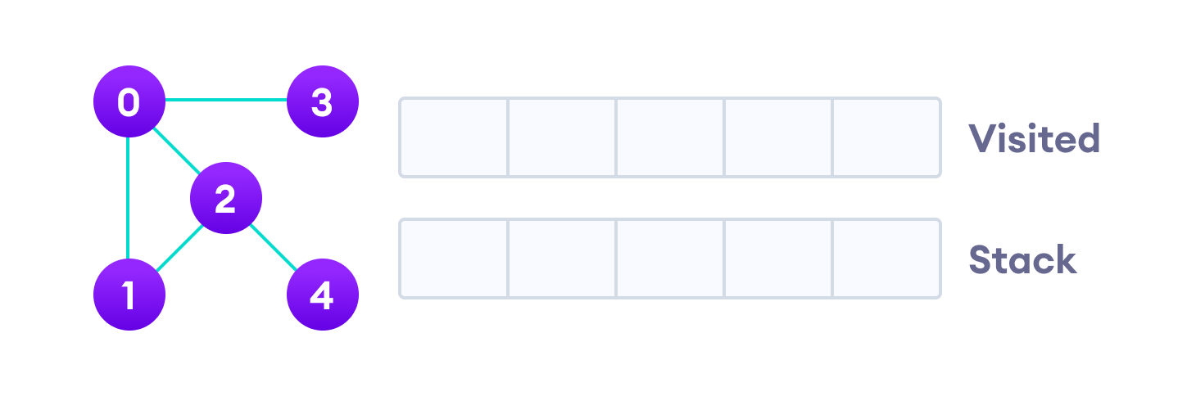
Depth First Search (DFS)
Depth First Search Example: Let's see how the Depth First Search algorithm works with an example. We use an undirected graph with 5 vertices.

Slide 8
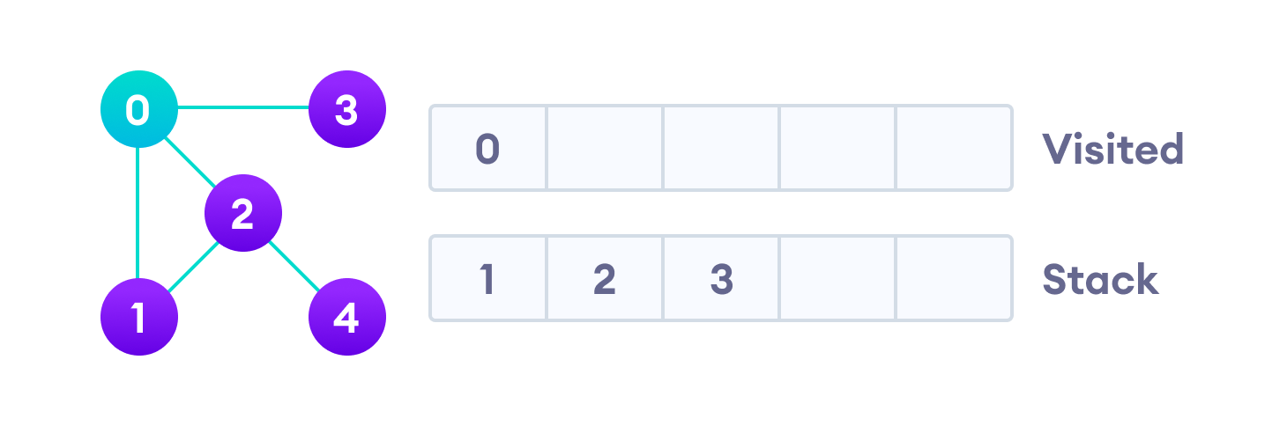
Depth First Search (DFS)
We start from vertex 0, the DFS algorithm starts by putting it in the Visited list and putting all its adjacent vertices in the stack.

Slide 9
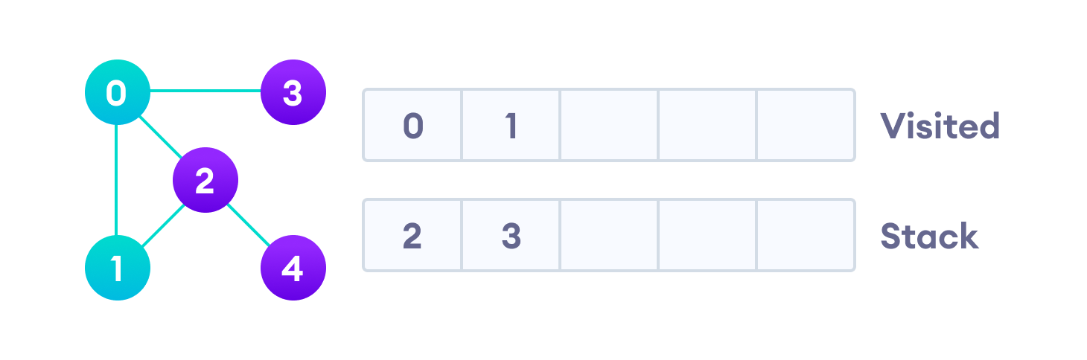
Depth First Search (DFS)
Next, we visit the element at the top of stack i.e. 1 and go to its adjacent nodes. Since 0 has already been visited, we visit 2 instead.

Slide 10
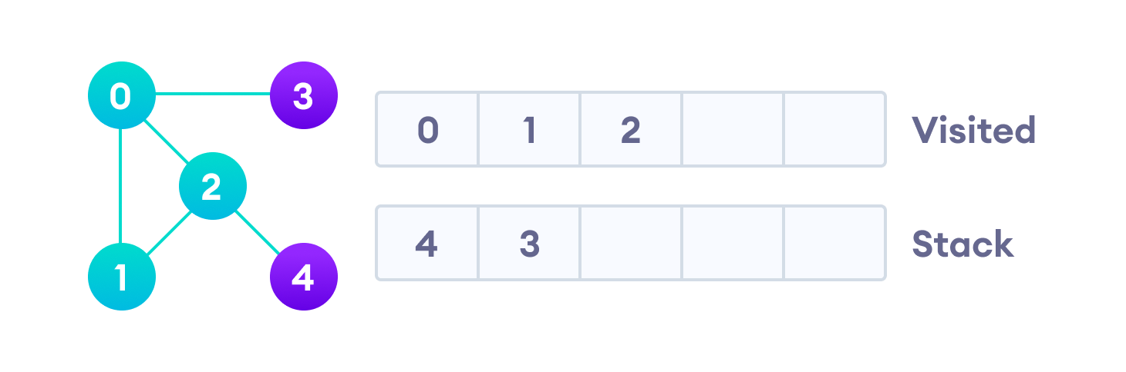
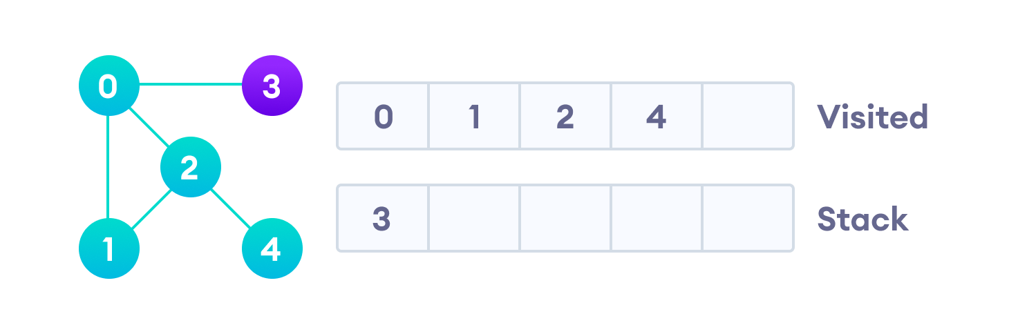
Depth First Search (DFS)
Vertex 2 has an unvisited adjacent vertex in 4, so we add that to the top of the stack and visit it.

Slide 11
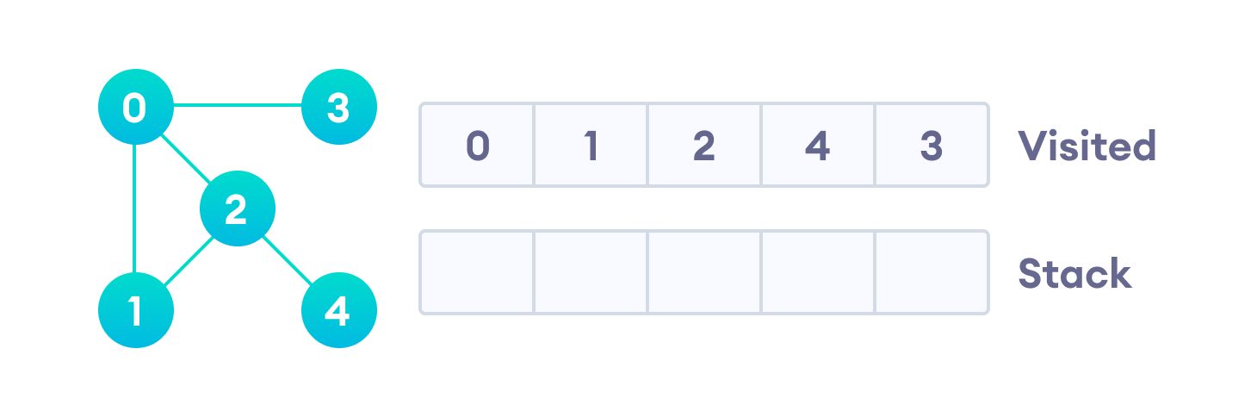
Depth First Search (DFS)
After we visit the last element 3, it doesn't have any unvisited adjacent nodes, so we have completed the Depth First Traversal of the graph.

Slide 12
Depth First Search (DFS)
Complexity of Depth First Search
The time complexity of the DFS algorithm is represented in the form of O(V + E), where V is the number of nodes and E is the number of edges.

Slide 13
Breadth first search
Breadth First Traversal or Breadth First Search is a recursive algorithm for searching all the vertices of a graph or tree data structure.
BFS algorithm
A standard BFS implementation puts each vertex of the graph into one of two categories:
Visited
Not Visited
The purpose of the algorithm is to mark each vertex as visited while avoiding cycles.
The algorithm works as follows:
Start by putting any one of the graph's vertices at the back of a queue.
Take the front item of the queue and add it to the visited list.
Create a list of that vertex's adjacent nodes. Add the ones which aren't in the visited list to the back of the queue.
Keep repeating steps 2 and 3 until the queue is empty.
The graph might have two different disconnected parts so to make sure that we cover every vertex, we can also run the BFS algorithm on every node

Slide 14
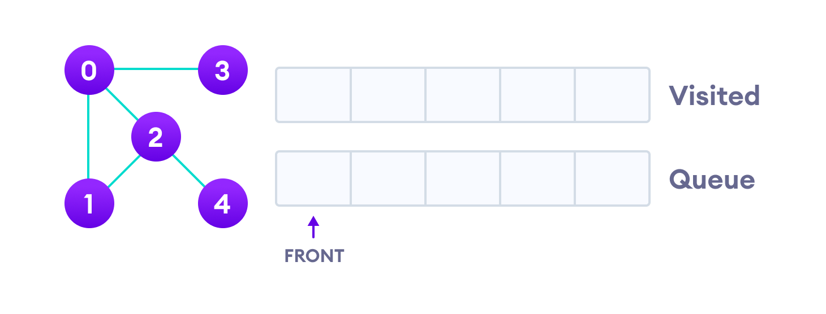
Breadth first search
BFS example
Let's see how the Breadth First Search algorithm works with an example. We use an undirected graph with 5 vertices.

Slide 15
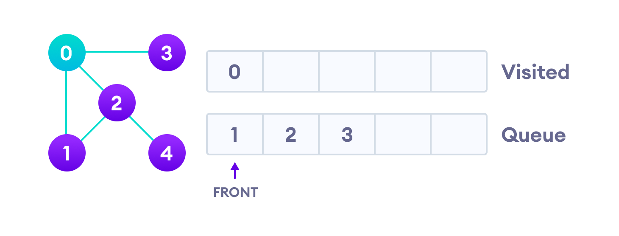
Breadth first search
We start from vertex 0, the BFS algorithm starts by putting it in the Visited list and putting all its adjacent vertices in the queue.

Slide 16
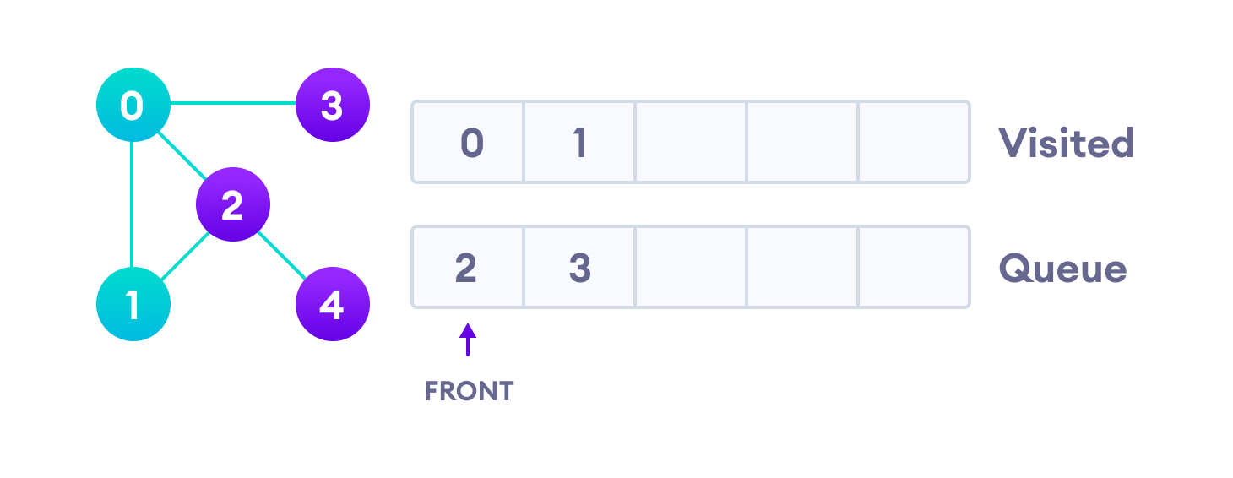
Breadth first search
Next, we visit the element at the front of queue i.e. 1 and go to its adjacent nodes. Since 0 has already been visited, we visit 2 instead.

Slide 17
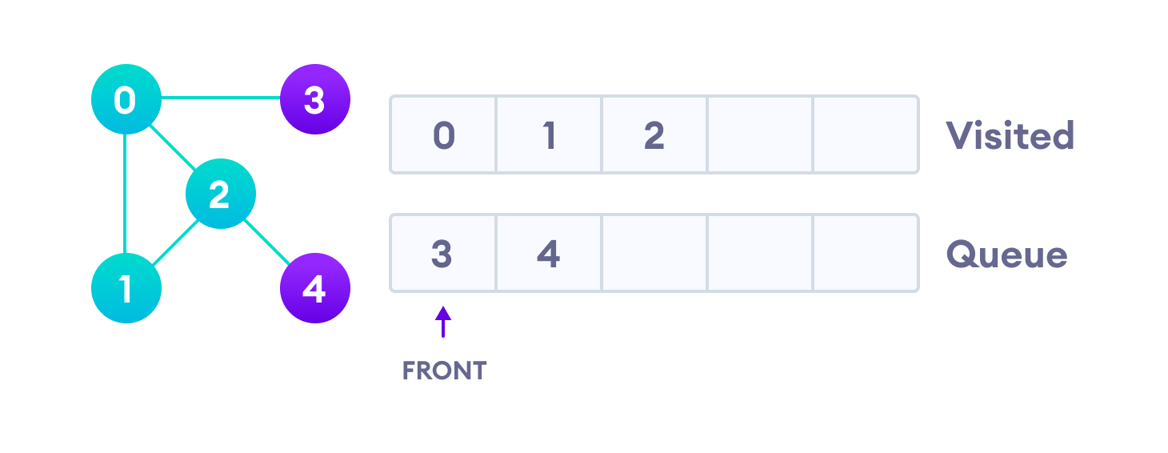
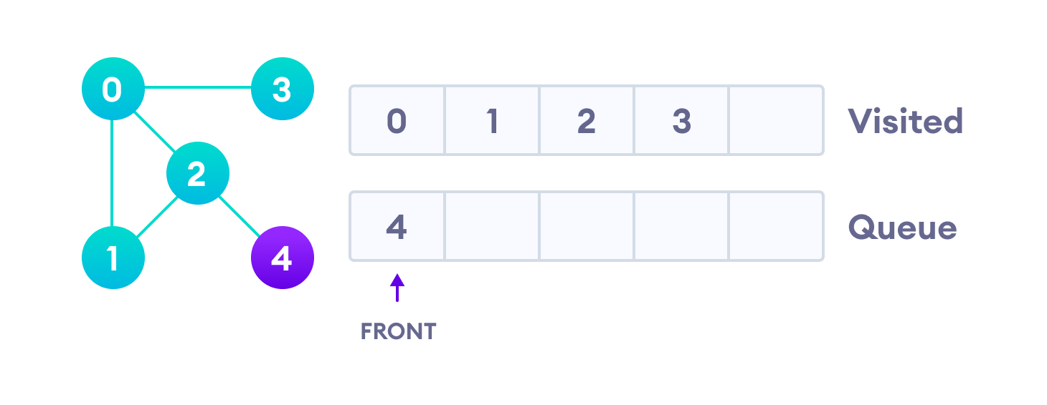
Breadth first search
Vertex 2 has an unvisited adjacent vertex in 4, so we add that to the back of the queue and visit 3, which is at the front of the queue.

Slide 18
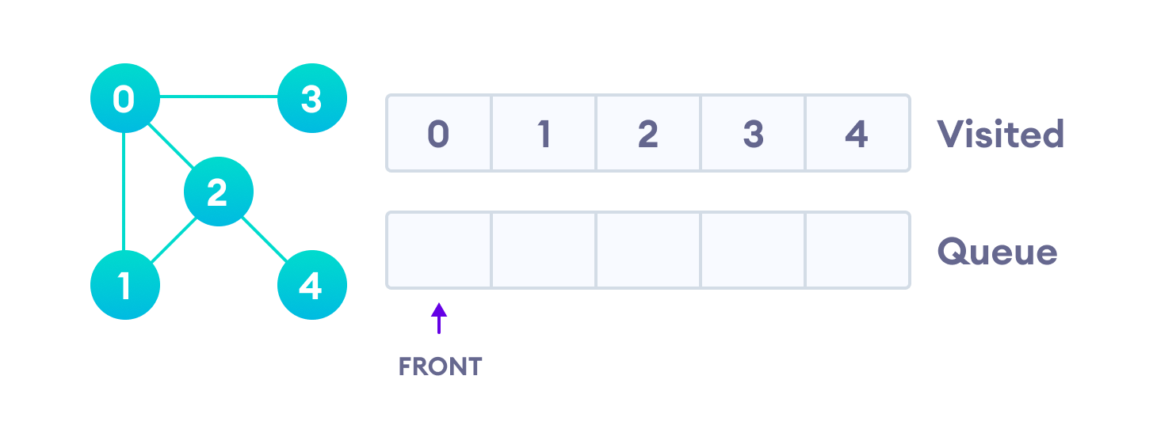
Breadth first search
Only 4 remains in the queue since the only adjacent node of 3 i.e. 0 is already visited. We visit it.
Since the queue is empty, we have completed the Breadth First Traversal of the graph.

Slide 19
Breadth first search
BFS Algorithm Complexity
The time complexity of the BFS algorithm is represented in the form of O(V + E), where V is the number of nodes and E is the number of edges.

Slide 20
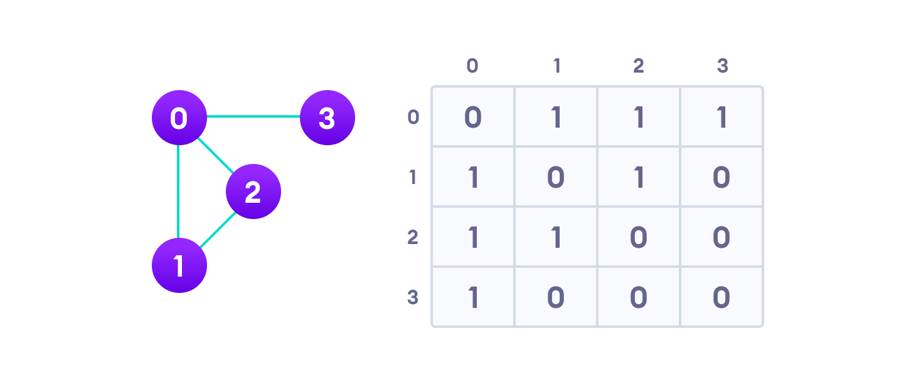
Graph Representation
Graphs are commonly represented in two ways:
1. Adjacency Matrix
An adjacency matrix is a 2D array of V x V vertices. Each row and column represent a vertex.
An adjacency matrix is a way of representing a graph as a matrix of booleans (0's and 1's). A finite graph can be represented in the form of a square matrix on a computer, where the boolean value of the matrix indicates if there is a direct path between two vertices.
If the value of any element a[i][j] is 1, it represents that there is an edge connecting vertex i and vertex j.
The adjacency matrix for the graph we created above is

Slide 21
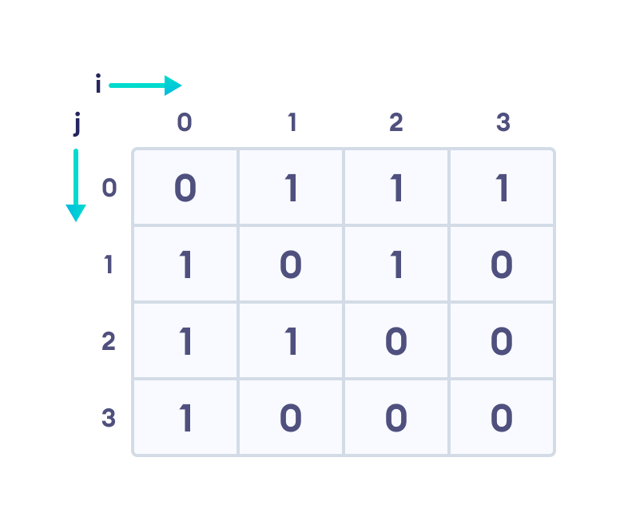
Graph Representation
Each cell in the below table/matrix is represented as A_{ij}, where i and j are vertices. The value of A_{ij} is either 1 or 0 depending on whether there is an edge from vertex i to vertex j.
If there is a path from i to j, then the value of A_{ij} is 1 otherwise its 0. For instance, there is a path from vertex 1 to vertex 2, so A₁₂ is 1 and there is no path from vertex 1 to 3, so A₁₃ is 0.
In case of undirected graphs, the matrix is symmetric about the diagonal because of every edge (i,j), there is also an edge (j,i).

Slide 22
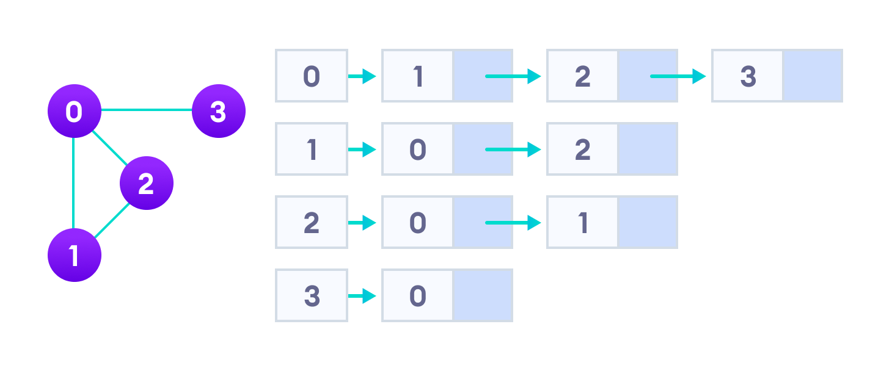
Graph Representation
2. Adjacency List
An adjacency list represents a graph as an array of linked lists.
The index of the array represents a vertex and each element in its linked list represents the other vertices that form an edge with the vertex.
The adjacency list for the graph we made in the first example is as follows:

Slide 23
Graph Representation
Here, 0, 1, 2, 3 are the vertices and each of them forms a linked list with all of its adjacent vertices. For instance, vertex 1 has two adjacent vertices 0 and 2. Therefore, 1 is linked with 0 and 2 in the figure above.
A simple dictionary of vertices and its edges is a sufficient representation of a graph.
graph = { 'A': set(['B', 'C']),
'B': set(['A', 'D', 'E']),
'C': set(['A', 'F']),
'D': set(['B']),
'E': set(['B', 'F']),
'F': set(['C', 'E'])
}

Slide 24
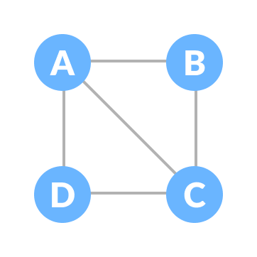
Spanning Tree and Minimum Spanning Tree
Before we learn about spanning trees, we need to understand two graphs: undirected graphs and connected graphs.
An undirected graph is a graph in which the edges do not point in any direction (ie. the edges are bidirectional).

Slide 25
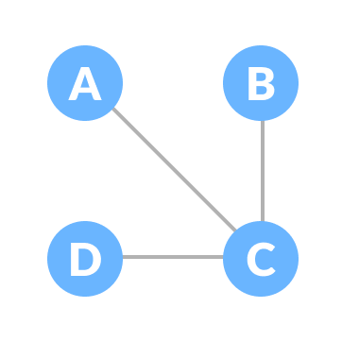
Spanning Tree and Minimum Spanning Tree
A connected graph is a graph in which there is always a path from a vertex to any other vertex

Slide 26
Spanning Tree and Minimum Spanning Tree
Spanning tree
A spanning tree is a sub-graph of an undirected connected graph, which includes all the vertices of the graph with a minimum possible number of edges. If a vertex is missed, then it is not a spanning tree.
The edges may or may not have weights assigned to them.
The total number of spanning trees with n vertices that can be created from a complete graph is equal to n^{(n-2)}.
If we have n = 4, the maximum number of possible spanning trees is equal to 4⁴⁻² = 16. Thus, 16 spanning trees can be formed from a complete graph with 4 vertices.

Slide 27
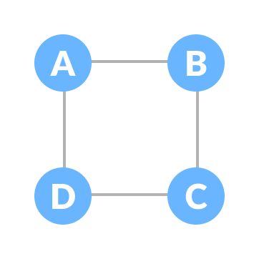
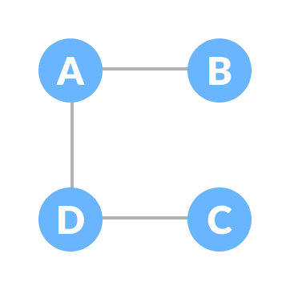
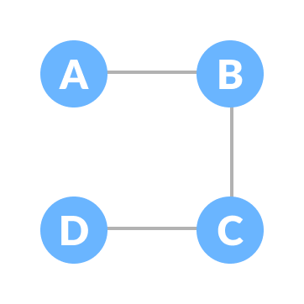
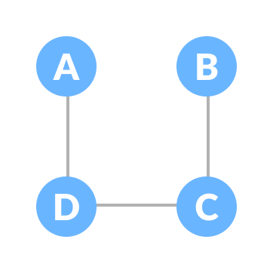
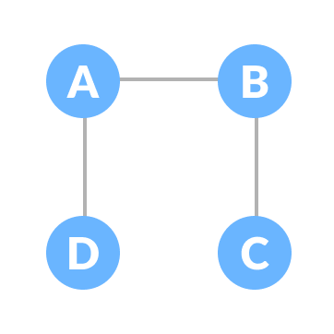
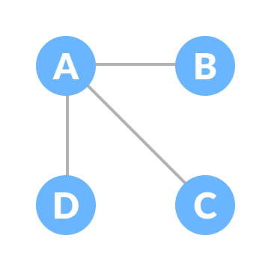
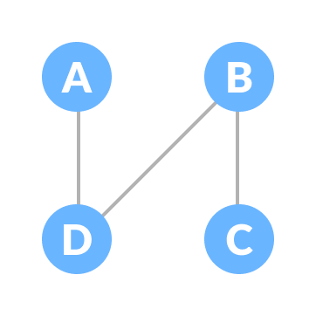
Spanning Tree and Minimum Spanning Tree
Example of a Spanning Tree
Let the original graph be:
Some of the possible spanning trees that can be created from the above graph are:

Slide 28
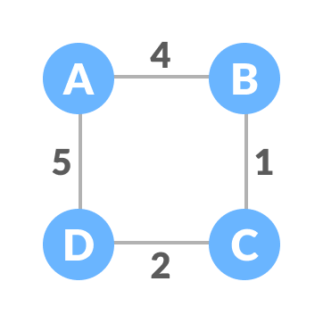
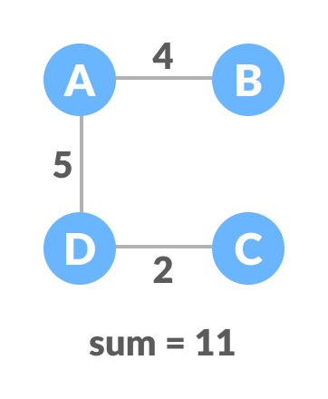
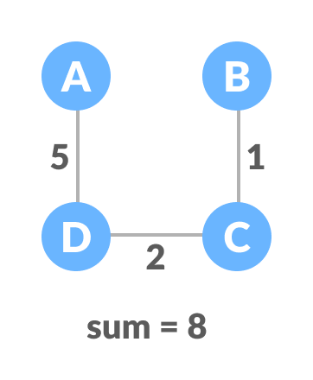
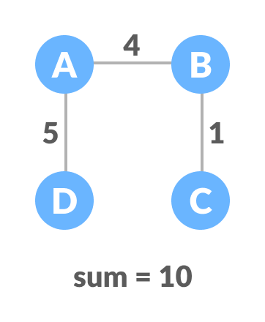
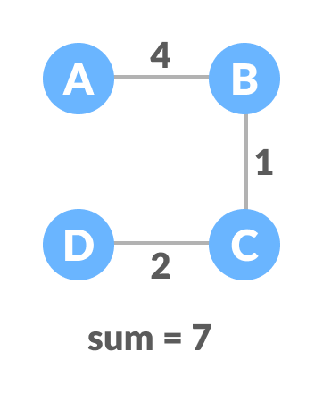
Spanning Tree and Minimum Spanning Tree
Minimum Spanning Tree
A minimum spanning tree is a spanning tree in which the sum of the weight of the edges is as minimum as possible.
Example of a Spanning Tree
The initial graph is:
The possible spanning trees from the above graph are:

Slide 29
Spanning Tree and Minimum Spanning Tree
The minimum spanning tree from the above spanning trees is:

Slide 30
Thank You

